Slide 1
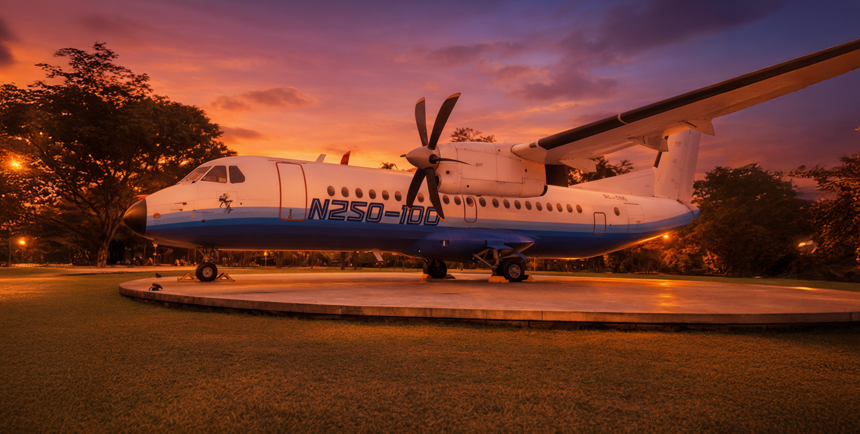














ICSEEA 2026
The 13th International Conference on Sustainable Energy Engineering and Application
The 13th International Conference on Sustainable Energy Engineering and Application
indexed:
indexed:
indexed:
Resilient Transportation and Clean Energy Shaping the Future of Sustainable Systems
Organized by:
Co-organized by:
📍 Hotel Trembesi BSD
Jl. Pahlawan Seribu Lot VIIA CBD - BSD, Lengkong Gudang, South Tangerang
02nd - 04th February 2026

Slide 2
ICSEEA 2026
The 13th International Conference on Sustainable Energy Engineering and Application
indexed:
indexed:
indexed:
Title of the Paper
Author Name¹, Author Name², Author Name³
Institution Logo Area (Right Side)
¹Affiliation of First Author
²Affiliation of Second Author
The 13th International Conference on Sustainable Energy Engineering and Application
Corresponding Author Email

Slide 3


Slide 4


